Slide 1
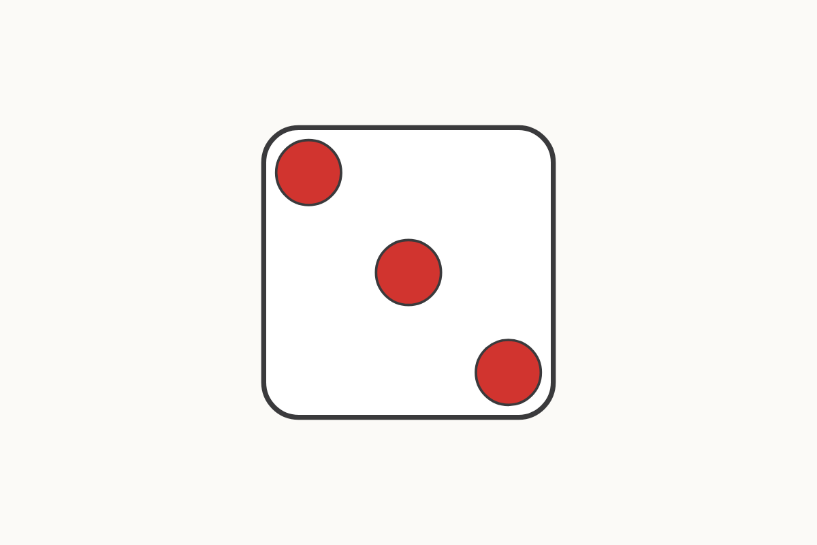
What do you see?
3
Education Makes Sense · educationmakessense.co.uk · Clear lessons. Confident learning.
Notes:
Show the card for two seconds. Ask: how many did you see? How did you see them?

Slide 2
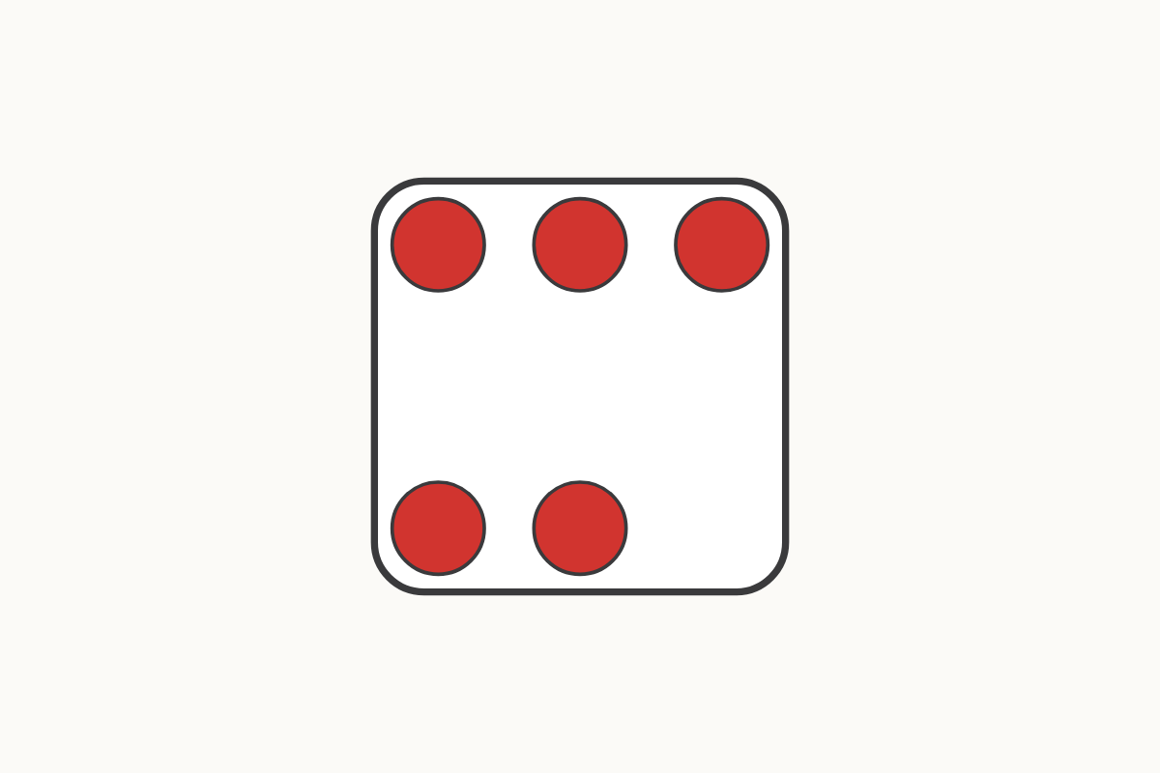
Look again
5
Education Makes Sense · educationmakessense.co.uk · Clear lessons. Confident learning.
Notes:
This is a new pattern. Ask children how they see it: 2 and 3, or 4 and 1?

Slide 3
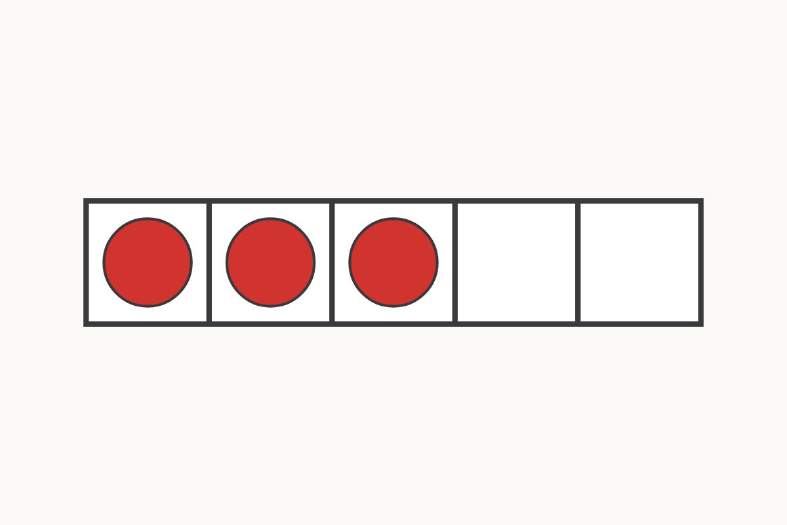
Five frame
3
Education Makes Sense · educationmakessense.co.uk · Clear lessons. Confident learning.
Notes:
Point to the full spaces, then the empty ones. Ask: how many more to make 5?

Slide 4
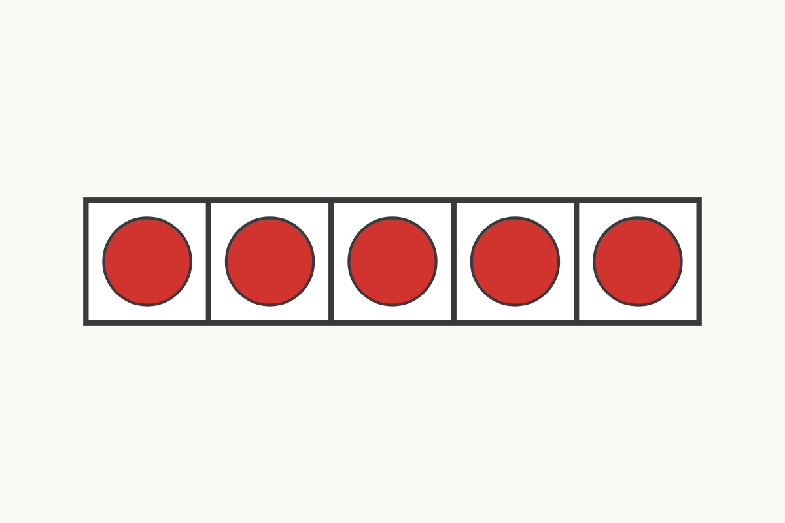
A full frame
5
Education Makes Sense · educationmakessense.co.uk · Clear lessons. Confident learning.
Notes:
The frame is full. Say together: 5. No empty spaces.

Slide 5
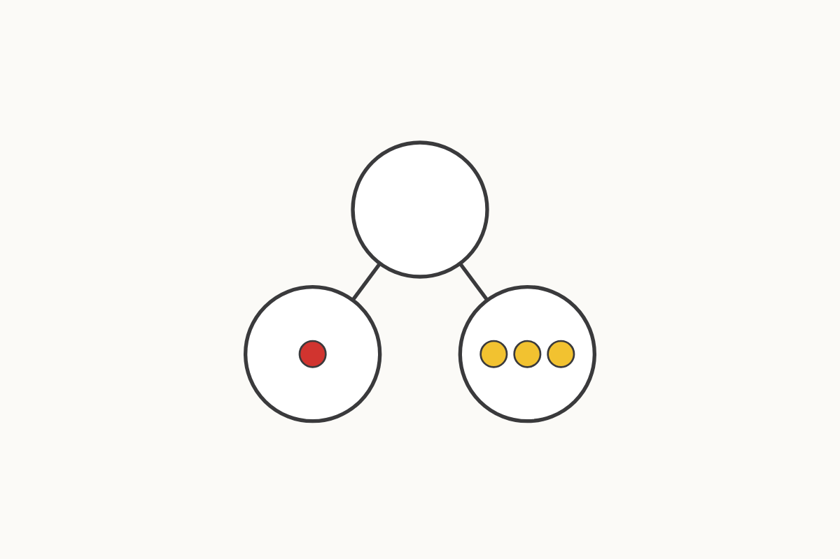
Part and whole
4
Education Makes Sense · educationmakessense.co.uk · Clear lessons. Confident learning.
Notes:
Point to the whole, then each part. Say: 1 and 3 make 4.

Slide 6
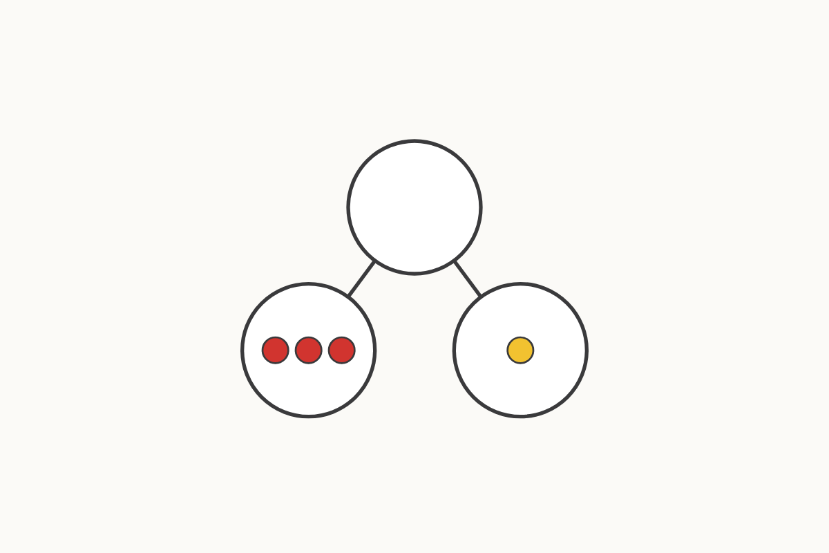
Another way
4
Education Makes Sense · educationmakessense.co.uk · Clear lessons. Confident learning.
Notes:
What has changed? Say together: 3 and 1 make 4. The whole is still 4.

Slide 7
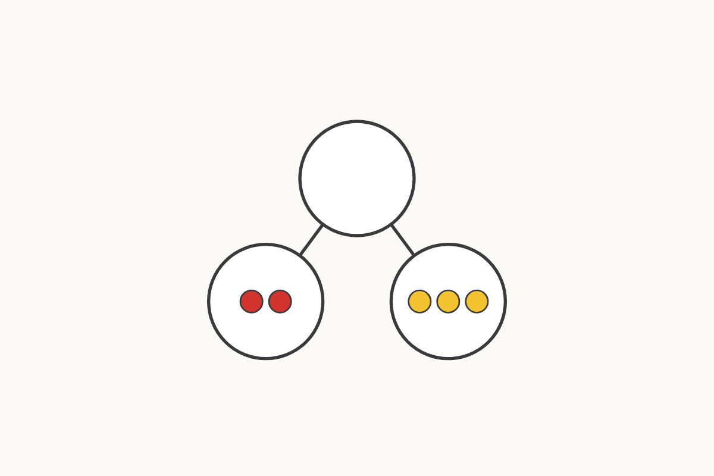
Making 5
5
Education Makes Sense · educationmakessense.co.uk · Clear lessons. Confident learning.
Notes:
Count the parts. Say: 2 and 3 make 5.

Slide 8
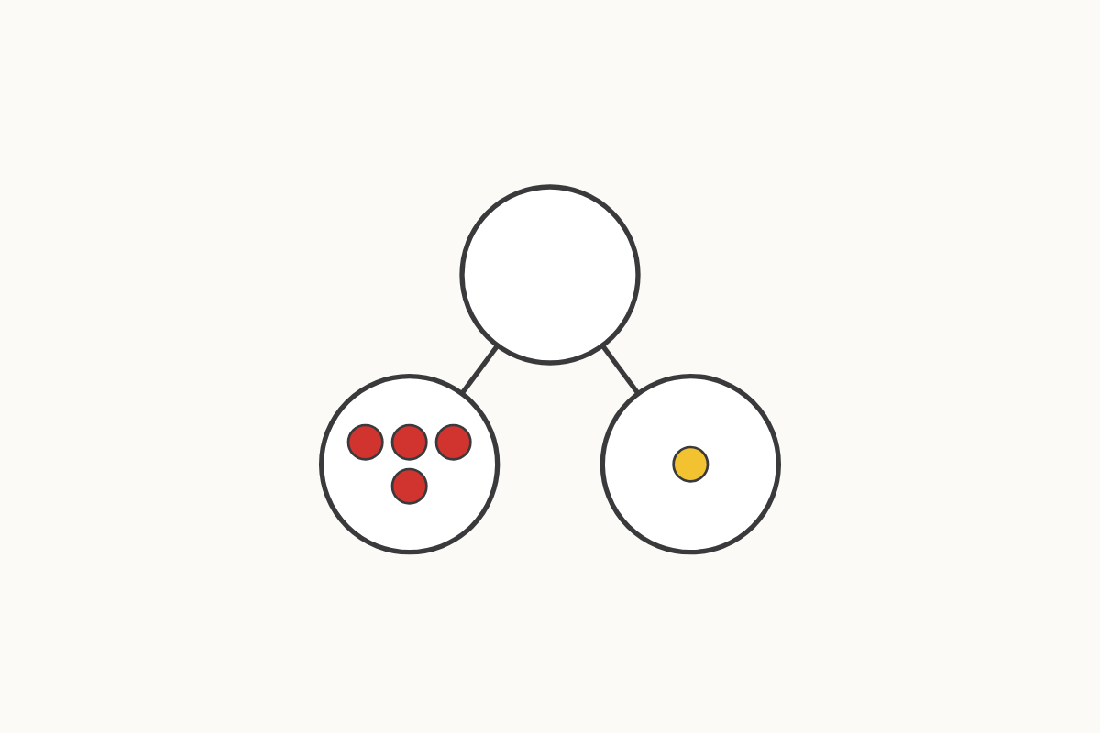
Another way to make 5
5
Education Makes Sense · educationmakessense.co.uk · Clear lessons. Confident learning.
Notes:
Ask: is this a different way? Say: 4 and 1 make 5.

Slide 9
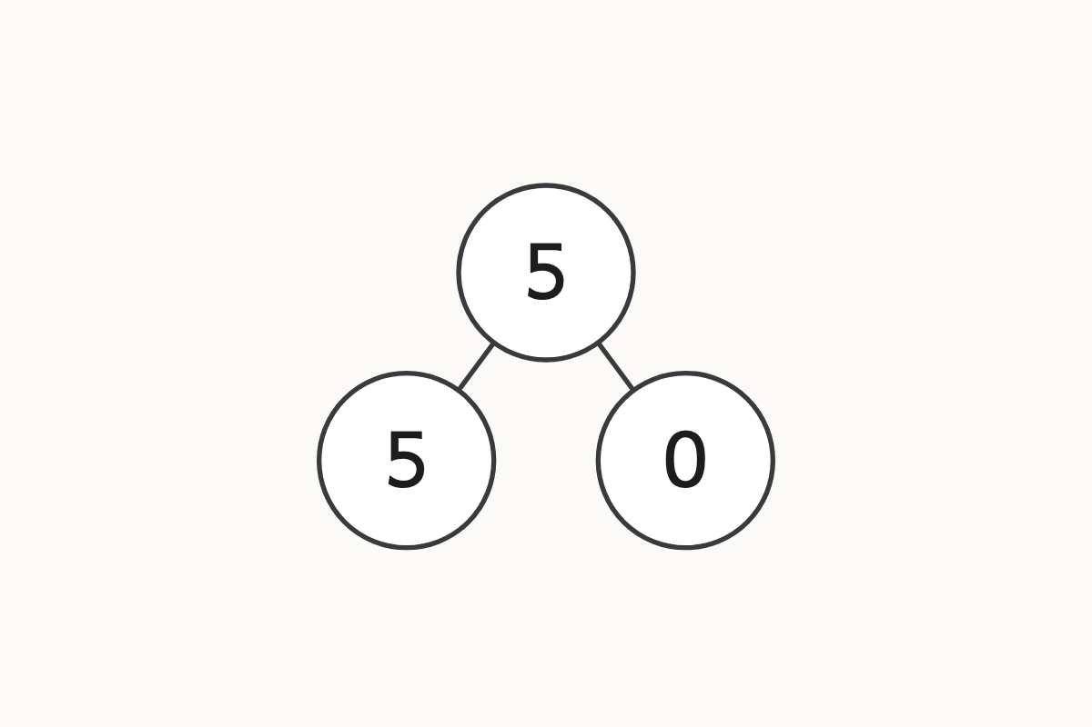
Zero is a part
5 and 0
Education Makes Sense · educationmakessense.co.uk · Clear lessons. Confident learning.
Notes:
One part has none. Say together: 5 and 0 make 5.

Slide 10
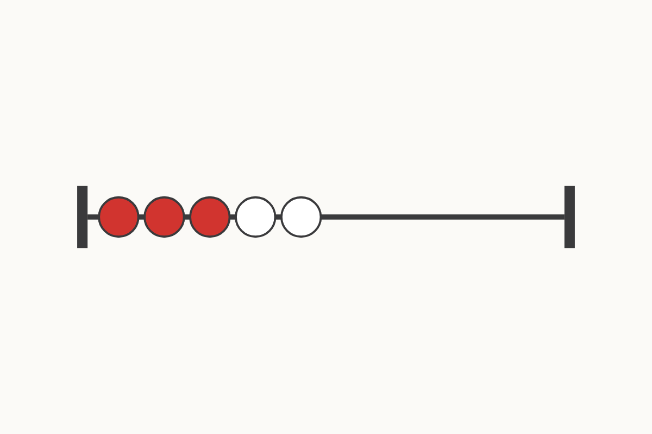
Beads
3 and 2
Education Makes Sense · educationmakessense.co.uk · Clear lessons. Confident learning.
Notes:
Count the beads of each colour. Ask: how many altogether?

